Slide 1
A PROJECT PRESENTATION ON
“DENIAL OF SERVICE USING MYSQL RELATIONAL
DATABASE STRUCTURE BASED ON NETWORK SECURITY.”
GUIDED BY:
ZAKIR HUSSAIN
PRESENTED BY: MAINAK ROY

Slide 2
OUTLINE
Overview
Software Requirements Specifications
Database Used In this Project
Tables Used in Each Databases
Queries and Final Goal

Slide 3
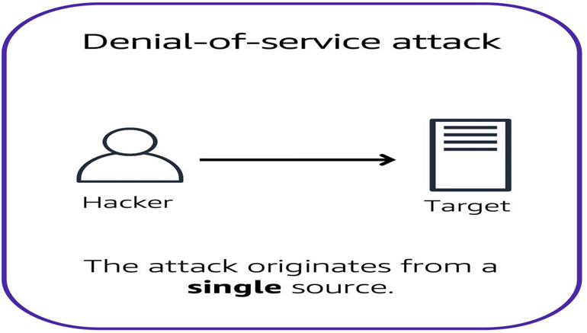
Overview
Denial-of-service attacks: A denial-of-service (DoS) attack is a deliberate attempt to make a website or application unavailable to users.
A Denial of Service (DoS) attack is a type of cyber attack where an attacker attempts to make a computer or network resource unavailable by overwhelming it with traffic or requests. The goal of a DoS attack is to exhaust the resources capacity, making it unable to handle legitimate requests.

Slide 4
Types of DOS attacks
Volume-Based Attacks: Volume-based attacks flood a network with too much data, overpowering its bandwidth and making the network unusable.
Protocol Attacks: Protocol attacks exploit weaknesses in network protocols to use up server resources. Examples are SYN floods and the Ping of Death.
Application Layer Attacks: Application layer attacks target specific applications or services, causing them to crash or become very slow.

Slide 5
Common Dos attack Techniques
FLOODING
BUFFERFLOW
MALFORMED PACKETS
SYN FLOODING

Slide 6

Software Requirements Specifications:
•DBMS: SQL
•Installation Using Mysql Installer
•Mysql Workbench Shell And Workbench
•Processor: Intel
•RAM: Min. 4 GB
•HDD: Min. 250 GB

Slide 7
DataBase Used in This Project
01
Database 1: Attack_Detection:
Attack detection databases are used to identify and report potential security threats or attacks on a network or system.
02
Database 2: Network_Traffic:
The Network_Traffic database is a collection of tables that store information related to network traffic, such as data transmitted, source and destination IP addresses, protocols used, and timestamps.

Slide 8
DataBase Used in This Project
03
Database 3: System_Resources:
System resources refer to the hardware and software components of a computer system that are used to perform tasks and operations.
04
Database 4: Incident_Response:
Incident response refers to the process of reacting to and managing security incidents within an organization.
05
Database 5: Security_Information:
The Security_Information database is a collection of tables that store information related to security incidents, threats, vulnerabilities, and security measures within an organization.

Slide 9
Tables used in Each Database
Network_Traffic Database
• traffic
•protocols
• ip_addresses
• network_devices
•traffic_stats
Attack_Detection Database
•attacks
•attack_types
•sources
•detection_rules
•alerts
04
05
01
03
. Incident_Response Database
•incidents
•incident_types
• response_plans
•response_teams
•incident_reports
System_Resources Database
resource_usage
resources
•system_stats
• process_list
•user_sessions
02
5. Security_Information Database: vulnerabilities, patches, security_advisories, threat_intelligence, security_incidents

Slide 10

Queries for Dos Attack
The create queries of databases and tables, insert queries of values are available in the following link:
https://github.com/Mainahttps://github.com/Mainakroy050/Mainak_DOS_Project.gitkroy050/Mainak_DOS_Project.git

Slide 11
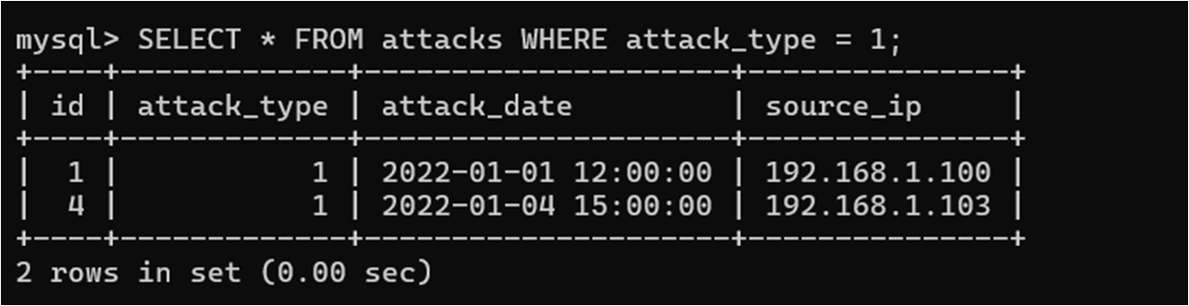
QUERIES EXAMPLES:
Filter records :
Retrieve information of attacks having attack_type = 1

Slide 12
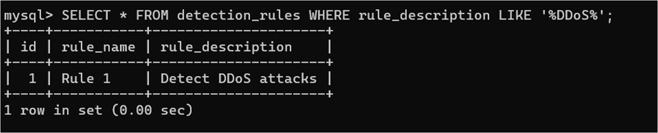
QUERIES EXAMPLES:
Retrieve rule description DDOS from detection_rules table

Slide 13
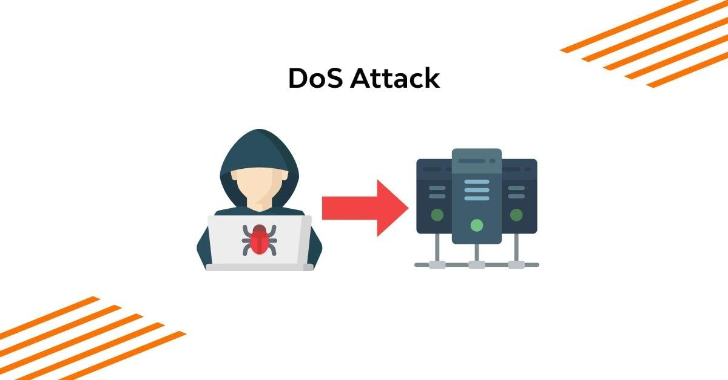

Thank you!

